Slide 1
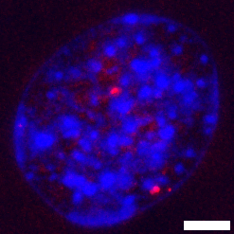
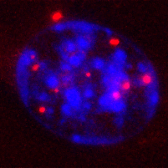
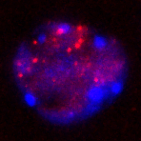
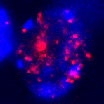
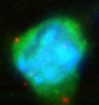
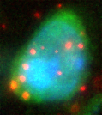
STHdh^{Q7/Q7}
STHdh^{Q111/111}
DAPI
PLA
LV-HTT25Q
LV-HTT72Q
WT
R6/2
Neurotrace

Slide 2
DAPI
cFos
Scale bar: 50μm, Arrow = “AI” – identified immunoreactive puncta
Speidell et al. (unpublished data)

Slide 3
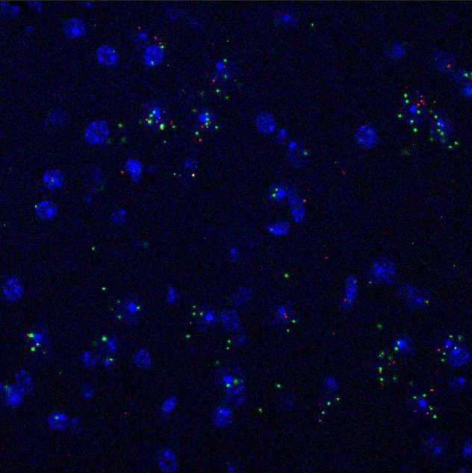
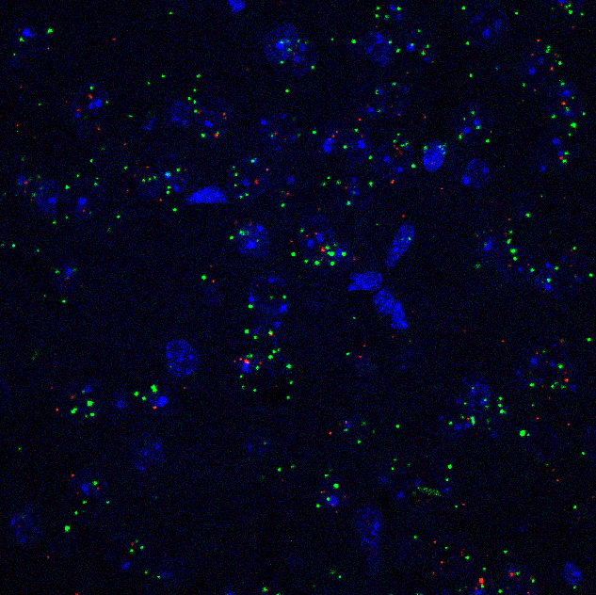
Dorsal Hypothalamus
Arcuate Nucleus, Hypothalamus
Scale bar: 50μm, Arrow = “AI” – identified immunoreactive puncta
Speidell et al. (unpublished data)

Slide 4
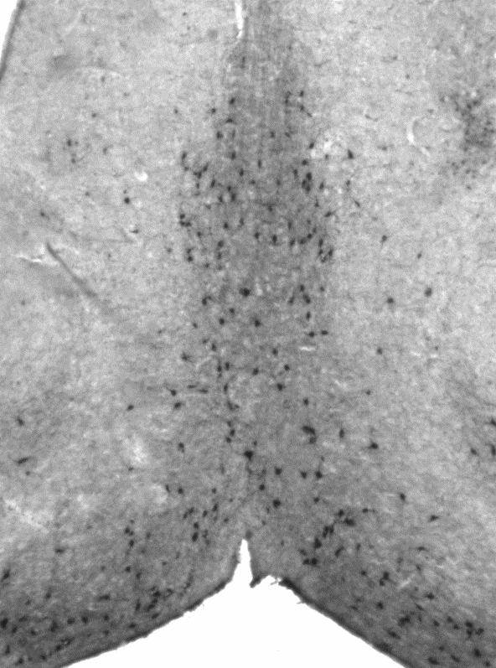
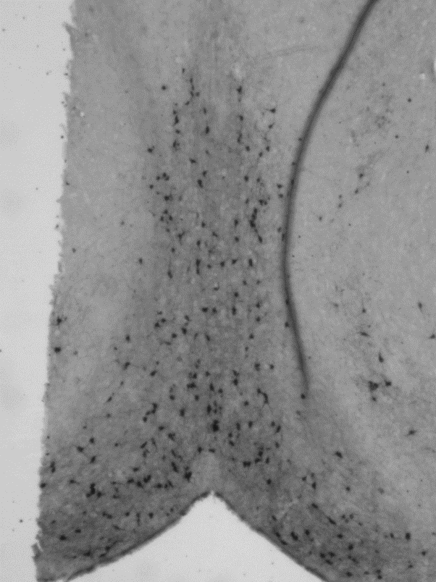
WT
gp120tg
p75^{NTR+/-}
p75^{NTR+/-}
gp120tg
Scale bar: 50μm, Arrow = “AI” – identified immunoreactive puncta
Speidell et al. (unpublished data)

